Slide 1
Experimental Design and Observational Analysis
Brian Caffo, Jeff Leek, Roger Peng
@bcaffo
www.bcaffo.com

Slide 2
On Experimental Design
To call in the statistician after the experiment is done may be no more than asking him to perform a post-mortem examination: he may be able to say what the experiment died of.
RA Fisher

Slide 3
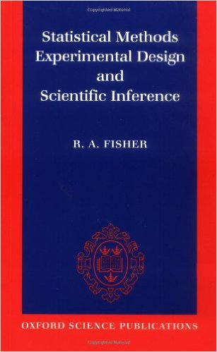
Observational Versus Designed Experiments
A large dichotomy in analysis comes in whether an experiment is designed or data is just observed (experimental versus observational data)

Slide 4
Observational Versus Designed Experiments
A large dichotomy in analysis comes in whether an experiment is designed or data is just observed (experimental versus observational data)
Good experimental design can help
Account for known important factors (blocking, stratification)
Account for unknown factors (randomization)
Get an unbiased sample (random sampling)
Eliminate the need for complex analyses
Isolate effects of interest

Slide 5
Observational Versus Designed Experiments
A large dichotomy in analysis comes in whether an experiment is designed or data is just observed (experimental versus observational data)
Good experimental design can help
Account for known important factors (blocking, stratification)
Account for unknown factors (randomization)
Get an unbiased sample (random sampling)
Eliminate the need for complex analyses
Isolate effects of interest
Observational experiments
Often feasible when designed experiments are not
Have large sample sizes
Cheaper to execute
Often require more complex modeling

Slide 6
In the next few lectures
In the next few lectures, we’ll look at some of the key topics in experimental design and observational analyses

Slide 7
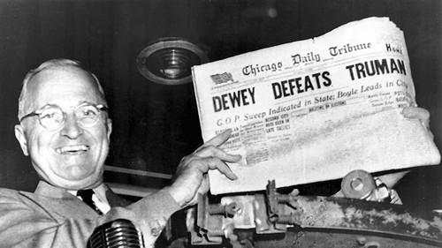
Bias

Slide 8
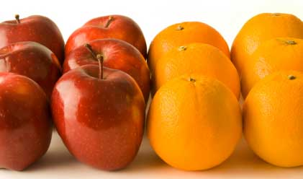
Randomization and A/B Testing
http://skillsprojects.files.wordpress.com/2009/10/like_for_like.jpg

Slide 9
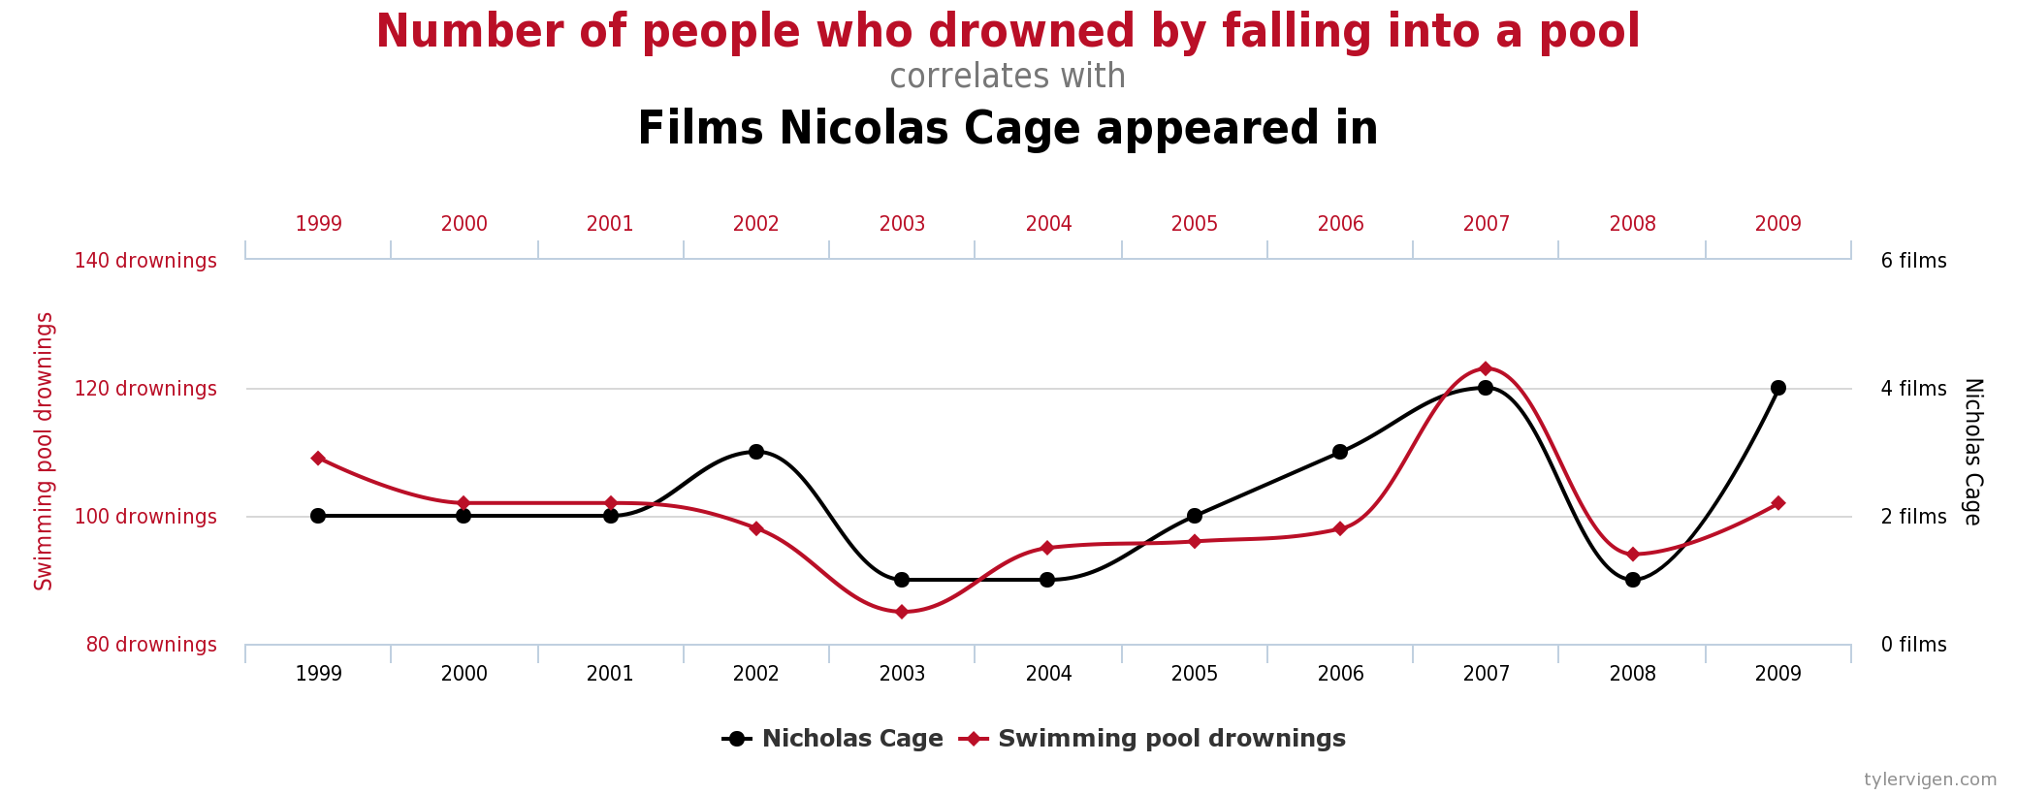
Confounding

Slide 10

Counterfactuals

Slide 11
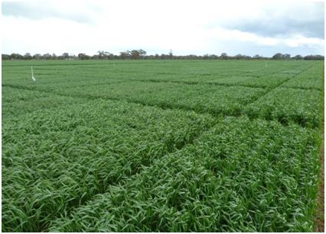
Blocking

